Slide 1


Approaches to Teaching R
By: Jenny Sloane
https://jennysloane.netlify.app/
@jfsloane
https://github.com/jennysloane/teaching-r

Slide 2
Overview
What online platforms would I recommend for teaching R?
In terms of content and teaching material, where should you start?
General Tips

Slide 3

My Experience Teaching R
Secondary school students: Workshops on Introduction to R and Data Science
Project: Choose a research question related to data on the Olympics or annual rainfall in Australia and use R to analyse data and graph results
High school students: Summer school on cognitive psychology
Project: Generate a unique hypothesis related to psychology experiments and use R to analyse and graph results
University students: Psychology course
Project: Reproduce results and figures from published articles

Slide 4
What online platforms would I recommend for teaching R?

Slide 5

“Data science without the hardware hassles”
Getting started is often the hardest part
Install R, download RStudio, install packages, load packages, etc.
Using RStudio Cloud avoids all the hassle!
Plans: free, premium, instructor, organization

Slide 6
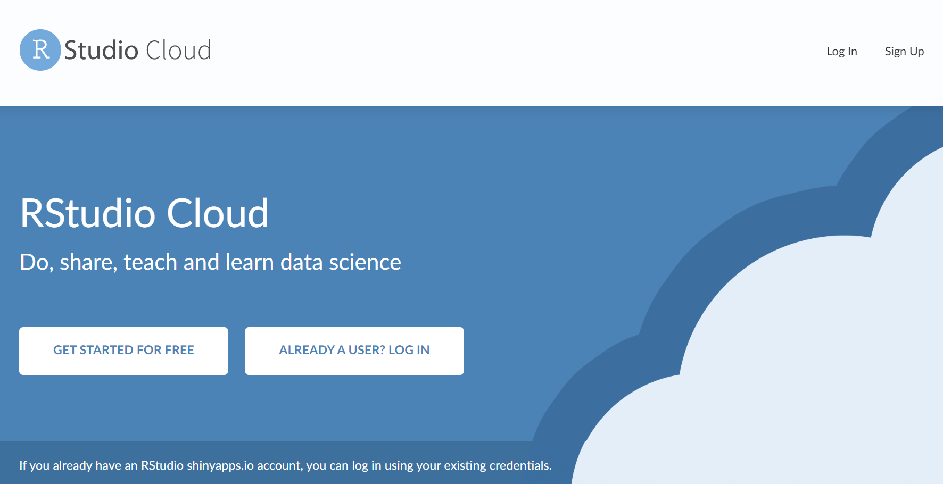
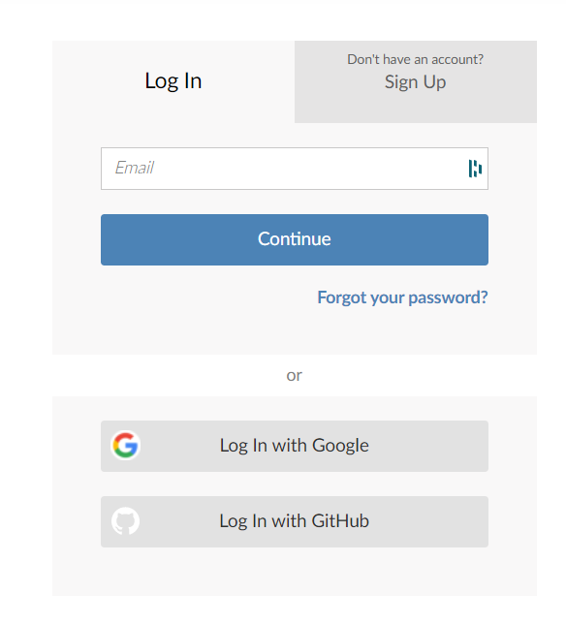
Log in: sign up or log in through Google or GitHub
https://rstudio.cloud/

Slide 7
You can create different workspaces and projects within the workspaces
Projects can easily be turned into “assignments” which is a great teaching tool
As the instructor/admin, you have access to all the projects
Great for checking in on students
Great for troubleshooting
Newscribo
Workspace
Workshop #1
Workshop #2
Final Project
Projects

Slide 8
After teaching a couple of courses and workshops using RStudio Cloud, I highly recommend it!
“Rstudio cloud was very helpful, especially because the mentors could help us with code we were stuck on”
*Reminder: students will eventually need to transition from RStudio Cloud to RStudio Desktop

Slide 9
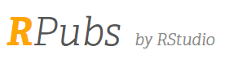
Free and easy to use!
Great for publishing and sharing R Markdown documents straight from Rstudio
Create an R Markdown document
Knit the file to see a preview
In the viewer pane, click publish and select RPubs
Note: you can easily update existing document
I’ve used RPubs to:
Share code and notes from courses with university students
Share code from RLadies meet-ups
https://rpubs.com/
Notes:
https://cran.r-project.org/web/packages/rpubs/readme/README.html – if you want to get the code from someone else’s RPubs

Slide 10
Let’s test it out!

Slide 11
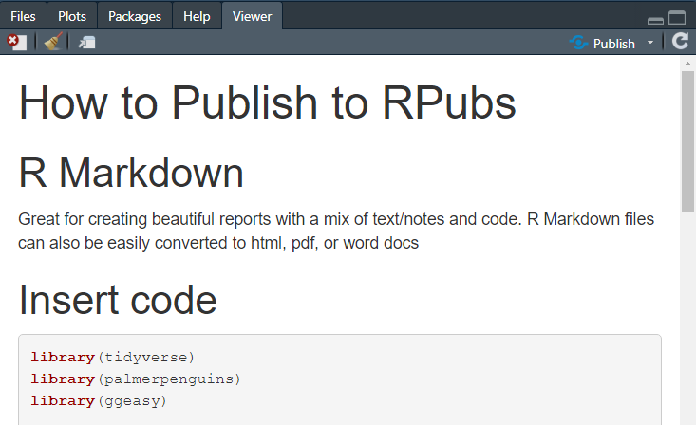
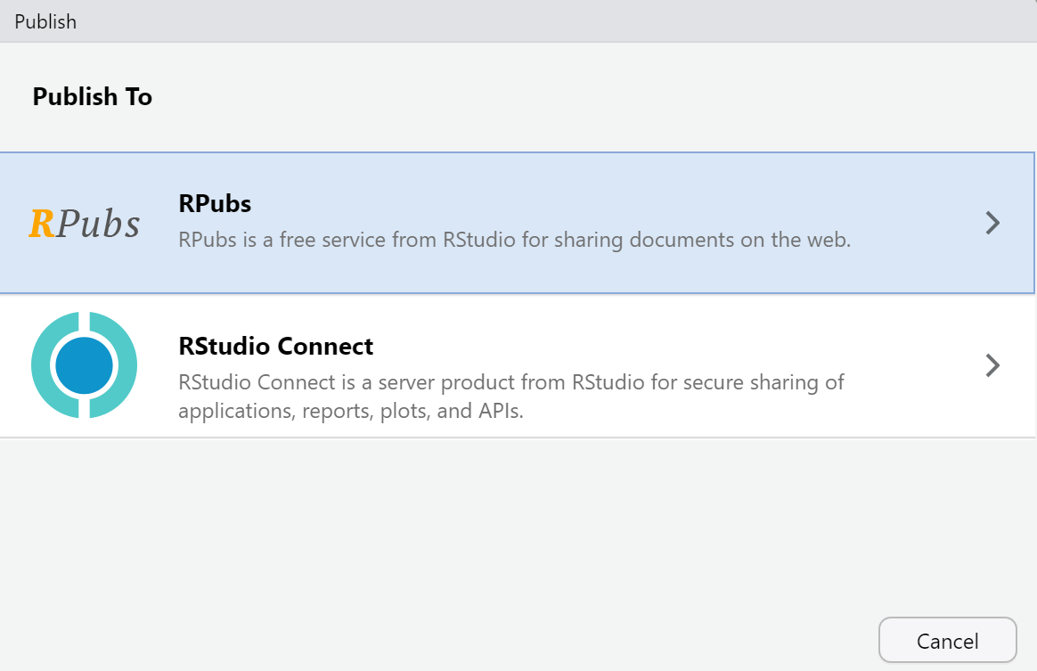
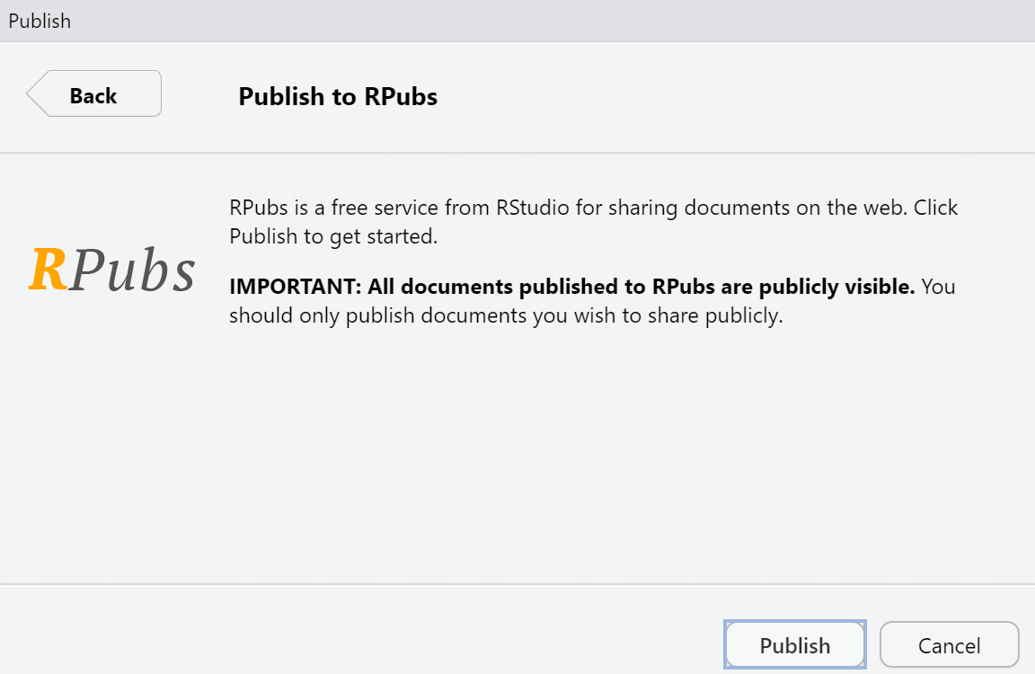
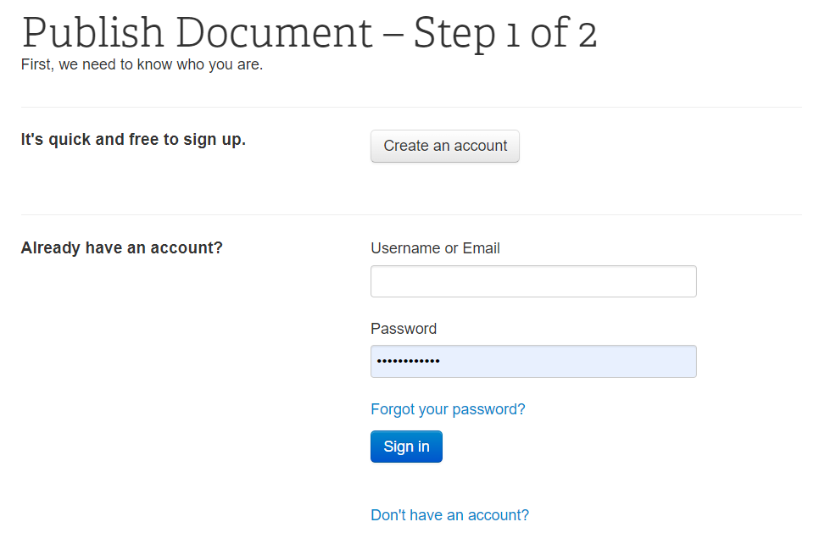
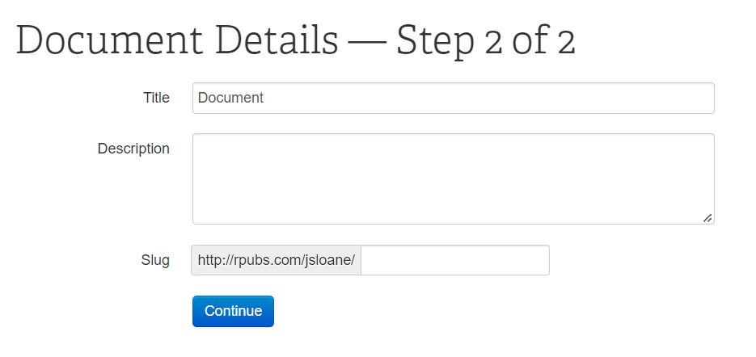

Slide 12
In terms of content and teaching material, where should you start?

Slide 13
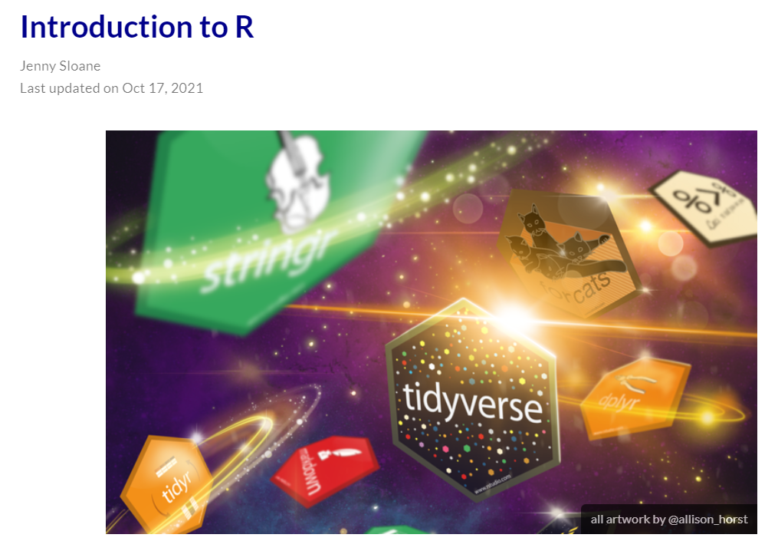
Blogs & Tutorials
Before spending hours creating content, see what’s already out there
R Resources for Beginners
Introduction to R Blog
Introduction to R Tutorials
learnr example

Slide 14


Websites
A bit more ambitious and advanced, but creating websites can be a great tool for teaching and sharing content
Distill
Great for making “simple” websites relatively quickly and easily
Less flexibility
Great tutorial for building websites with Distill by Dr. Maria Tackett
NEWScribo Website
R Girls Website

Slide 15
Websites
A bit more ambitious and advanced, but creating websites can be a great tool for teaching and sharing content
Blogdown
Much more flexibility in terms of design and layout
More complicated file structure
Takes longer to get the hang of
Alison Hill's Blog: Up & Running with Blogdown
My R Blogdown Blog
R Blogdown YouTube Playlist
My Academic Website
UNSW CodeRs Website

Slide 16
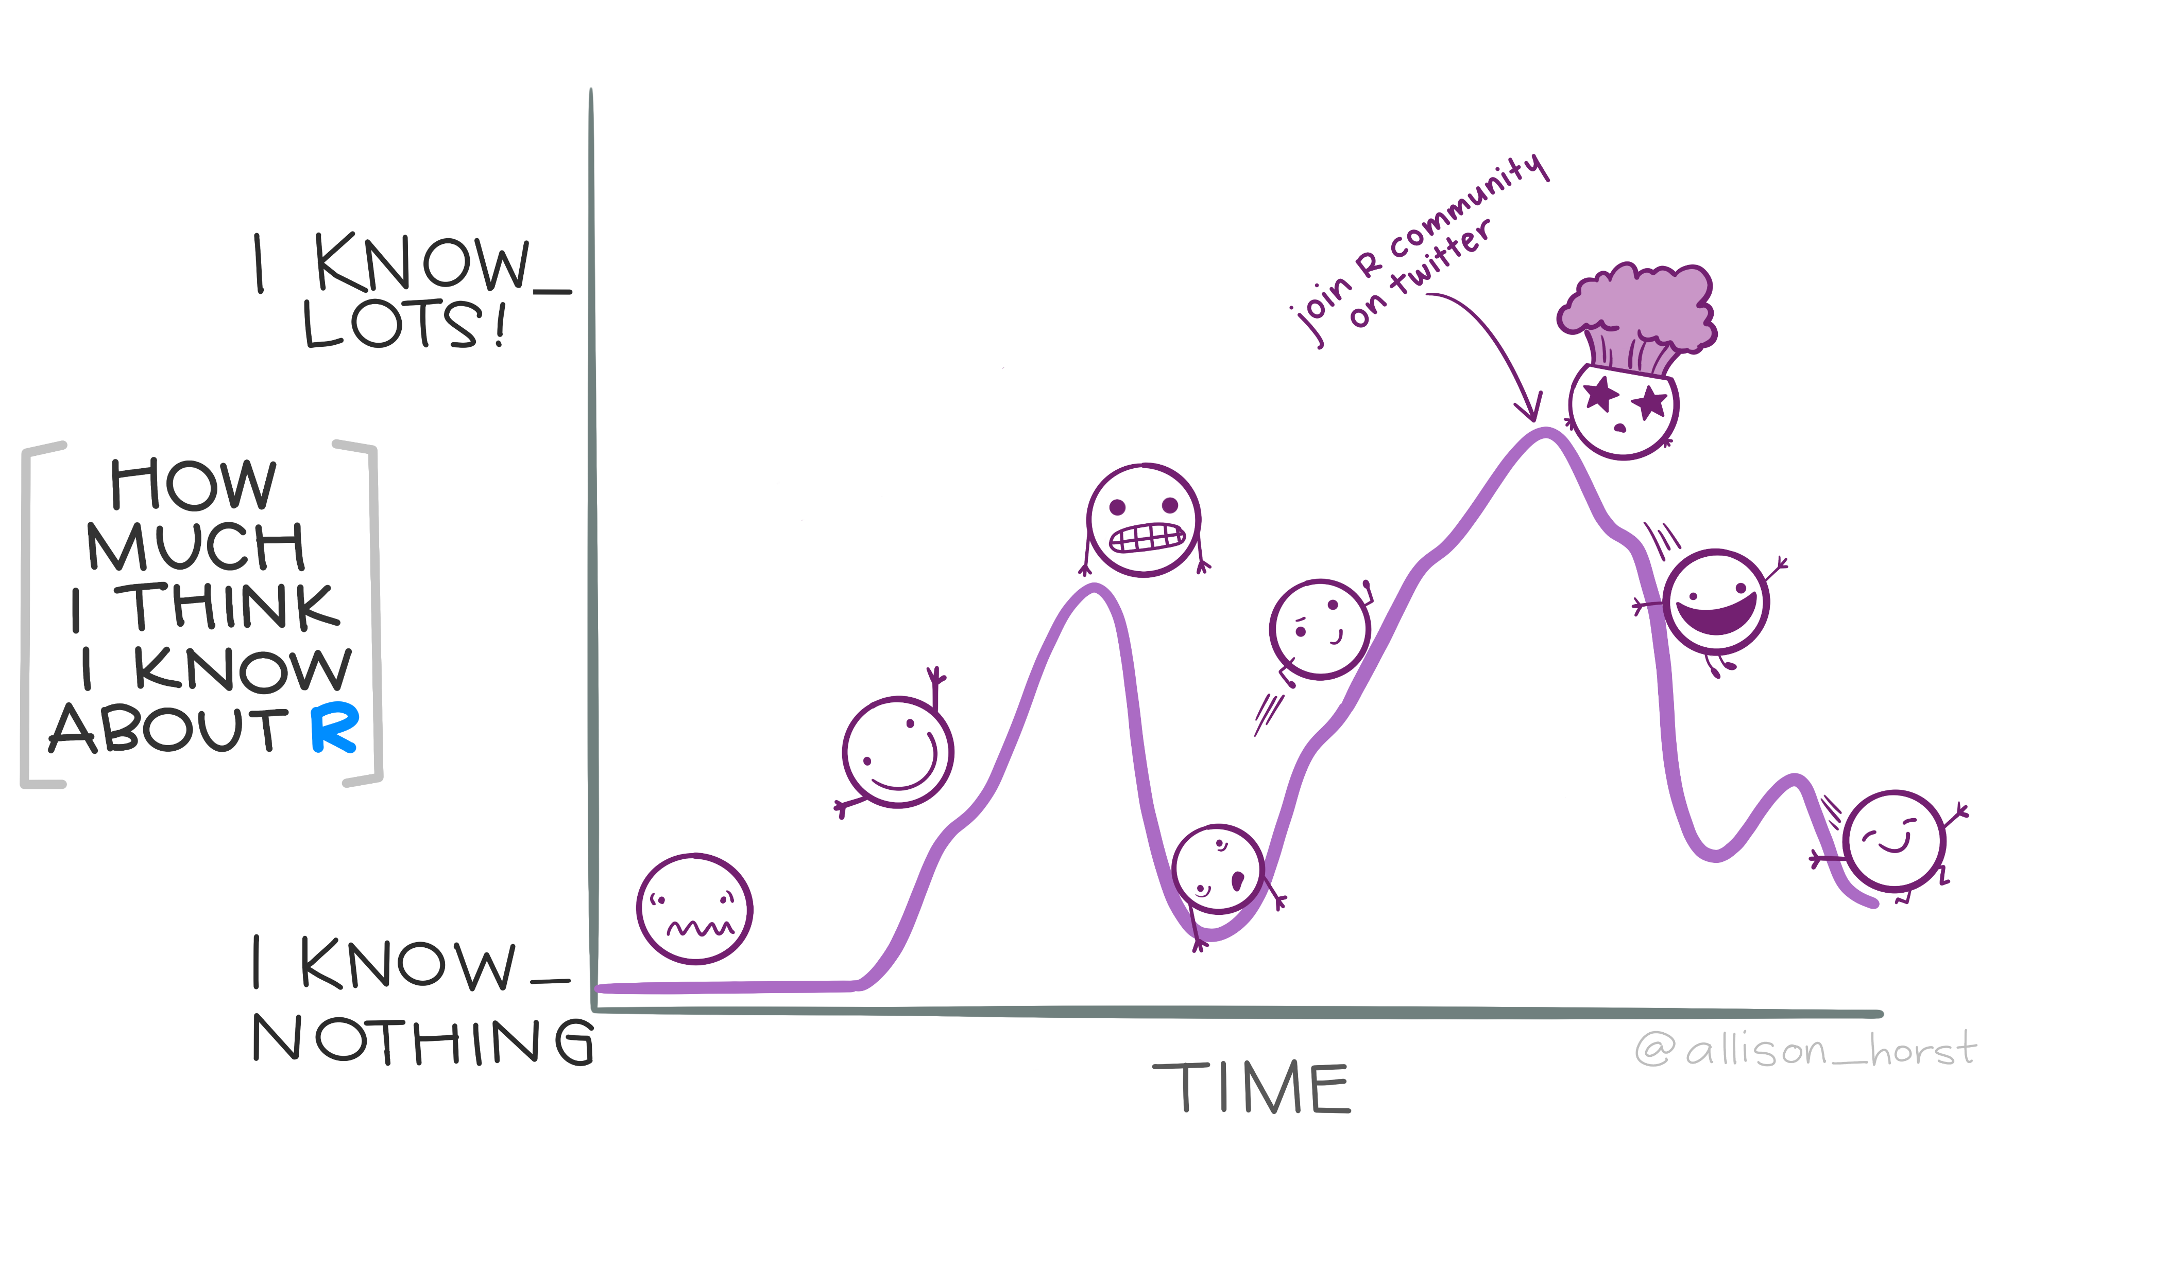
General Tips
Don’t skip over the basics
Installing and loading packages, understanding working directories, different types of variables, data frames, etc.
Consider age and if the students have any prior coding experience
Have a fun and concrete project
Be prepared to be amazed by how quickly students learn
Enjoy being part of the R community!

Slide 17

Thank you!

